Slide 1
StarCraft II International Competition Predictor
Jonathan Ko
Young Kim
Allen Chen

Slide 2
Goal
Professional StarCraft II has a pretty big scene around the world
We want to find the best players, and be able to (as accurately as possible) predict the outcome of a match
We also want to understand the metagame (how gameplay shifts)

Slide 3
Data
To produce a product like this and get results, we needed data, and it wasn’t easily available
Match information
date
winner
loser
map
races played
Map information

Slide 4
Data
teamliquid.net
Source of a lot of this information
They wouldn’t give it to us… (so we forcibly took it)
Wrote a scraper for teamliquid.net database, and just cycled through all the pages
Had to limit our collection rate…

Slide 5
Data
Data collected:
Date of match
League ID and name
Map ID and name
Winner ID and name
Winner Race
Loser ID and name
Loser Race

Slide 6
Visualization
We wanted to visualize two things:
Find the best players – that is, the strongest performing players with high confidence
Understand the metagame; particularly, race imbalances

Slide 7
Visualization
Find the best players – the strongest performing players with high confidence
Problems
Some players have played few games (2 to 5) and have high win percentages
Playing many games at a high level implies a high level of skill (getting invited to more tournaments, etc.)
We want to be able to balance number of games played as well as win rate!

Slide 8
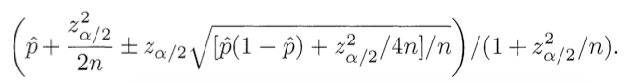
Visualization
Use the lower bound of Wilson score confidence for Bernoulli parameter
Accounts for low sample size, returns a score for confidence in player ability
Bubble chart
DEMO

Slide 9
Visualization
Also wanted to visualize the race-usage trends (and win rates) in professional StarCraft
Allows us to see metagame shifts, which map rotations favor which races, and even game balance changes
Bar chart
DEMO

Slide 10
Models
The real question: Can we predict who will win a game of Starcraft II?
The real answer: Kind of. It depends on what data we have access to. ;)

Slide 11
Models
How do we go about solving this?
Easy. Turn it into a classification problem!
Create a binary classifier around a player
Train the classifier on the player’s matches
Feed it information about upcoming matches
Convert classification to WIN or lose

Slide 12
Models
What classifiers though?
Logistic Regression
Decision Tree
Multinomial Bayes
Support Vector Machine
Random Forests
Ensembles
Stacking w/ Logistic Regression
Stacking w/ Multi-Response Linear Models

Slide 13
Models
Cool story bro, but what features?
For a match, we only know three things: player 1, player 2, and map, so…:
Player’s win rate against opp’s race on that map
Opp’s win rate against player’s race on that map
Player’s win rate against opp overall
Time (attenuated as a logistic function)

Slide 14
Models
To evaluate our feature selection, we ran a 10-fold CV for a given player, specifically the most awesome Terran player in the world, MVP.
To evaluate our model selection, we just stared at the ROC curves we made.

Slide 15
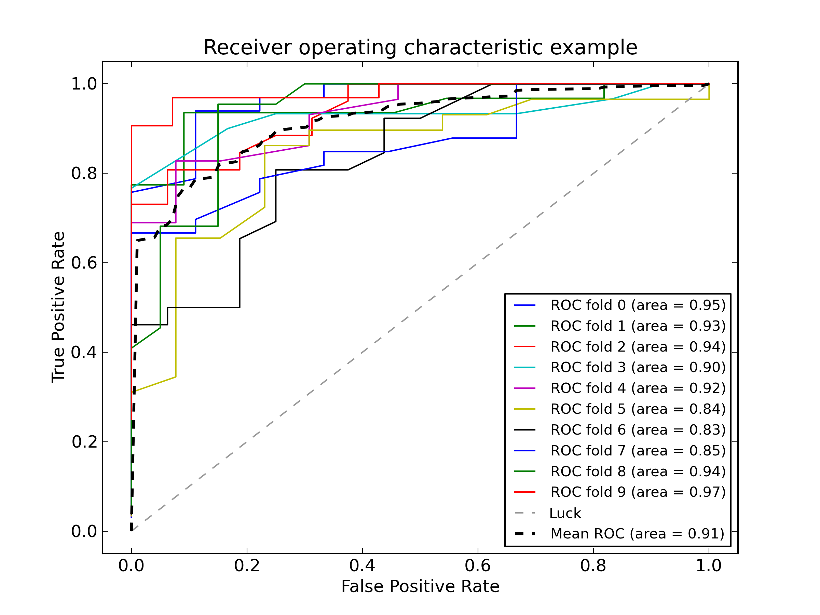
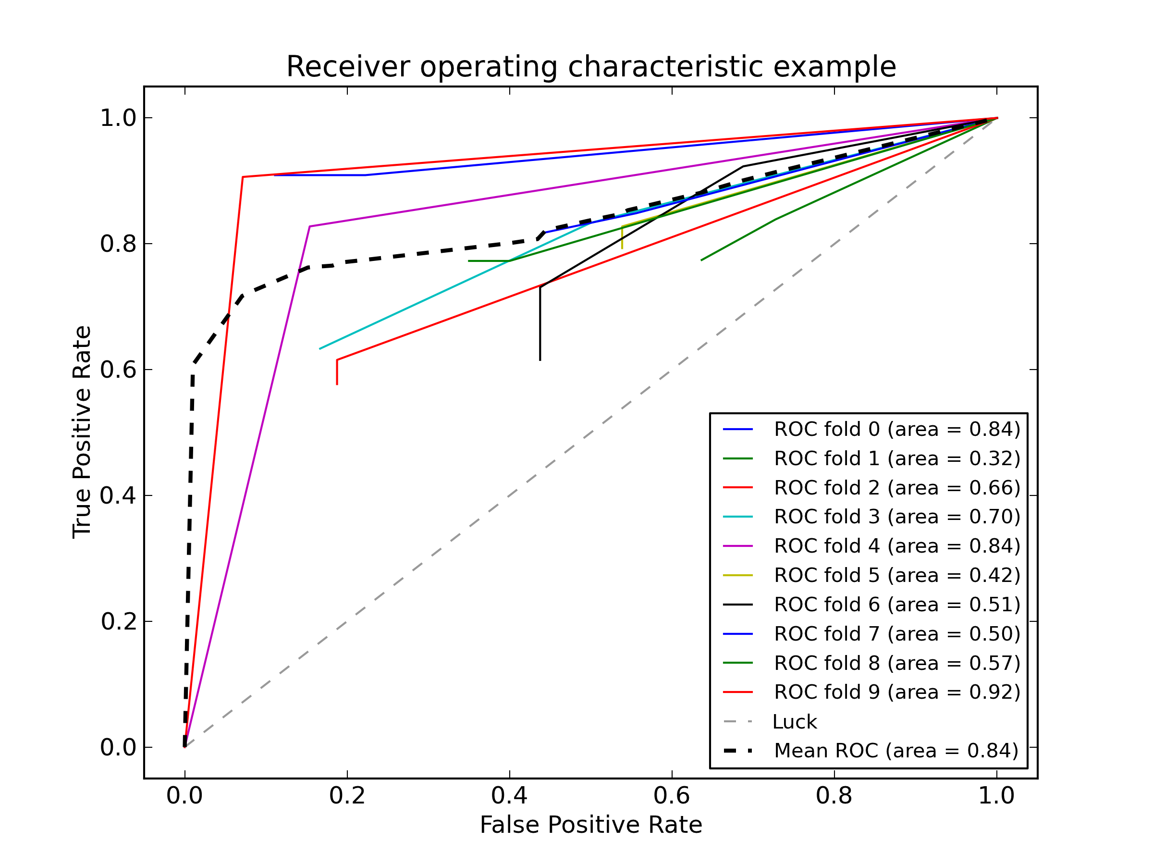
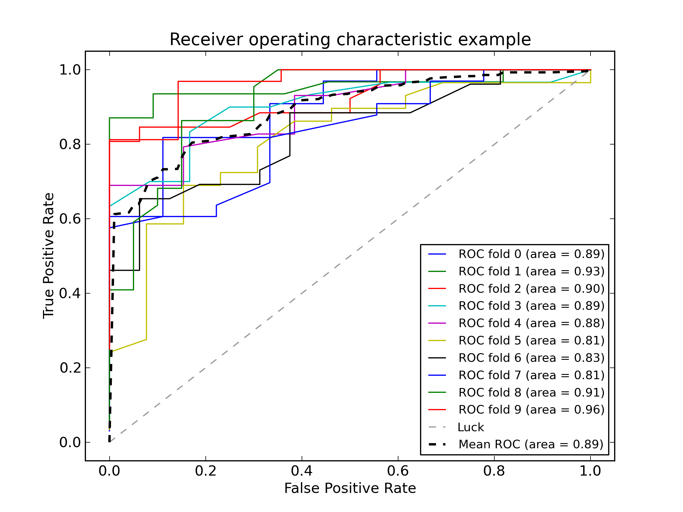

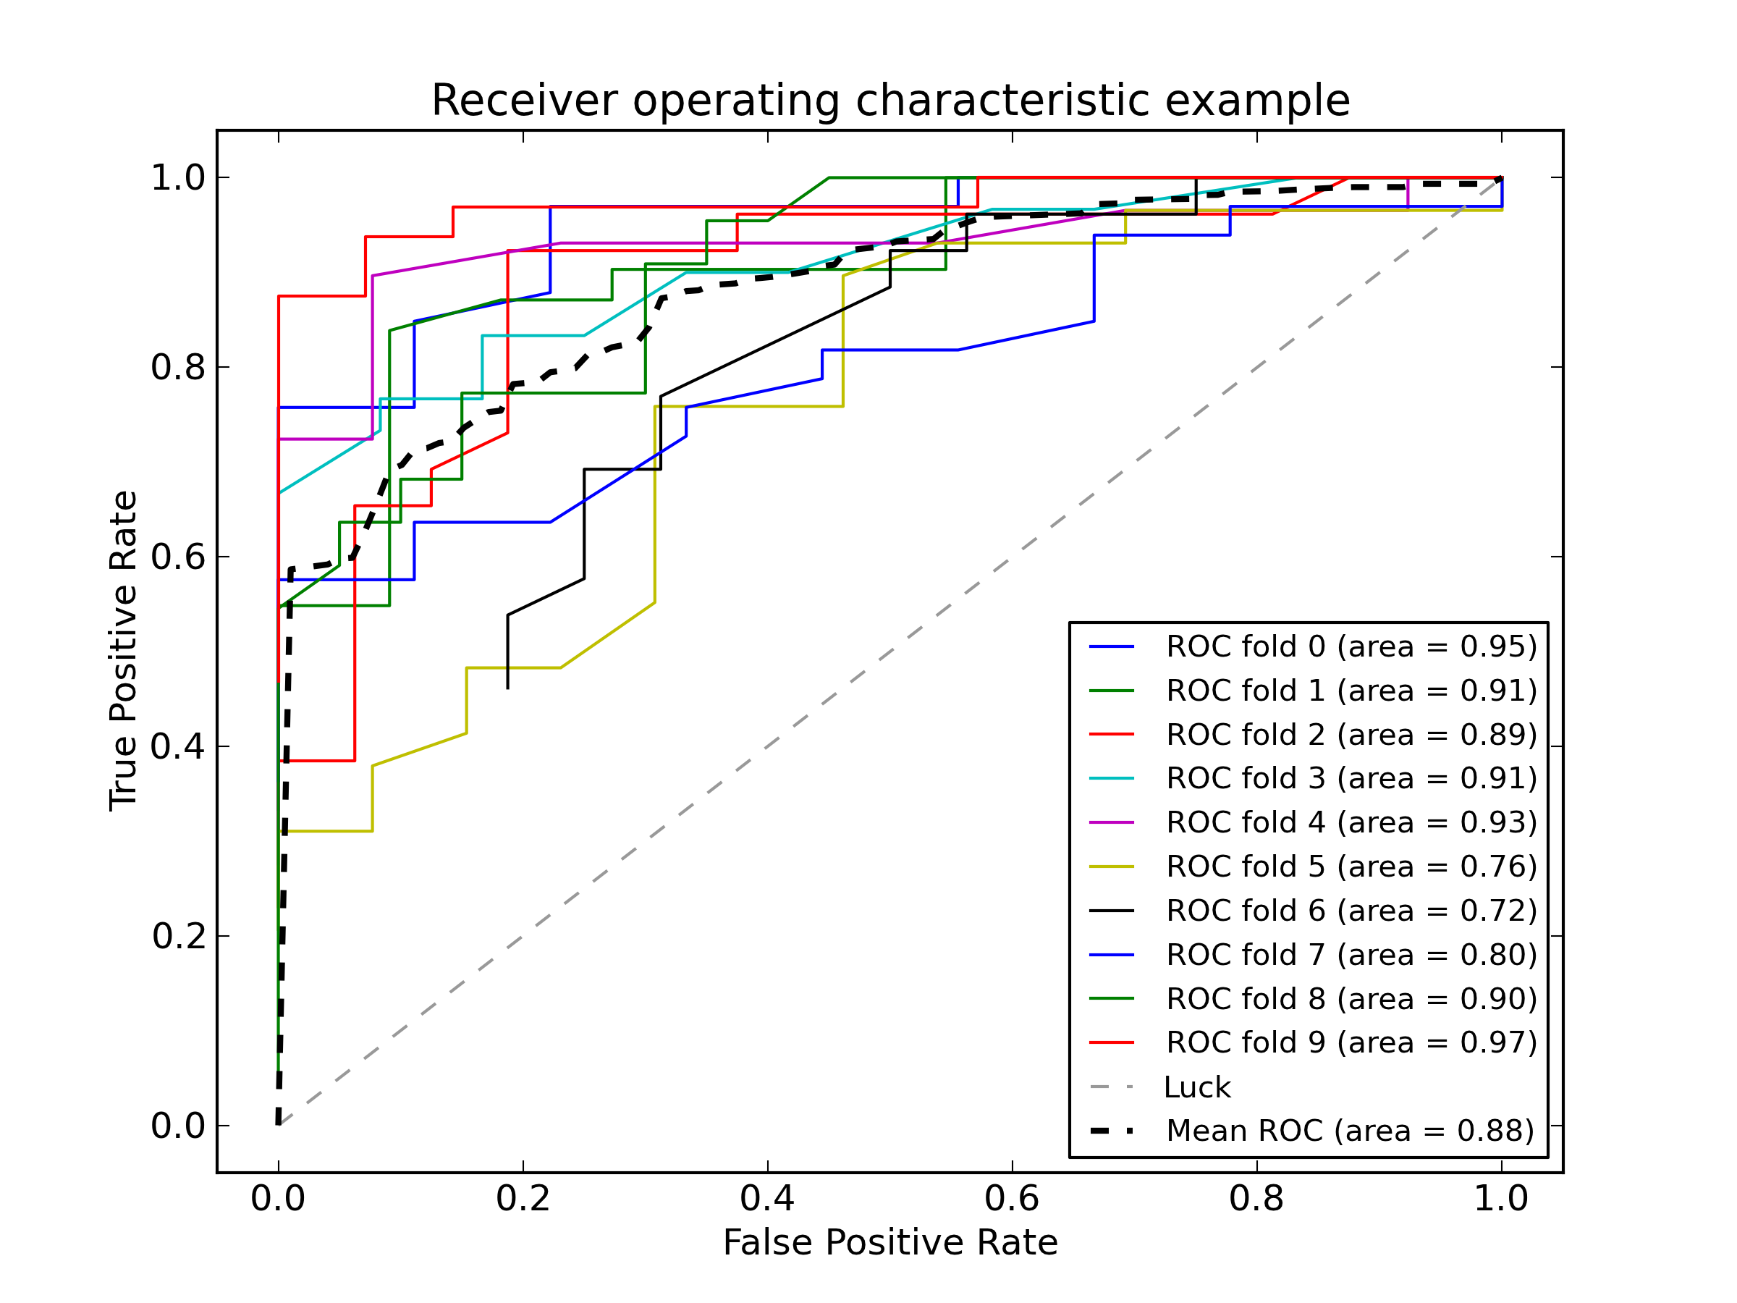
Models – Take One
Logistic Regression
Decision Tree
Multinomial Bayes
Support Vector Machines
Random Forests

Slide 16
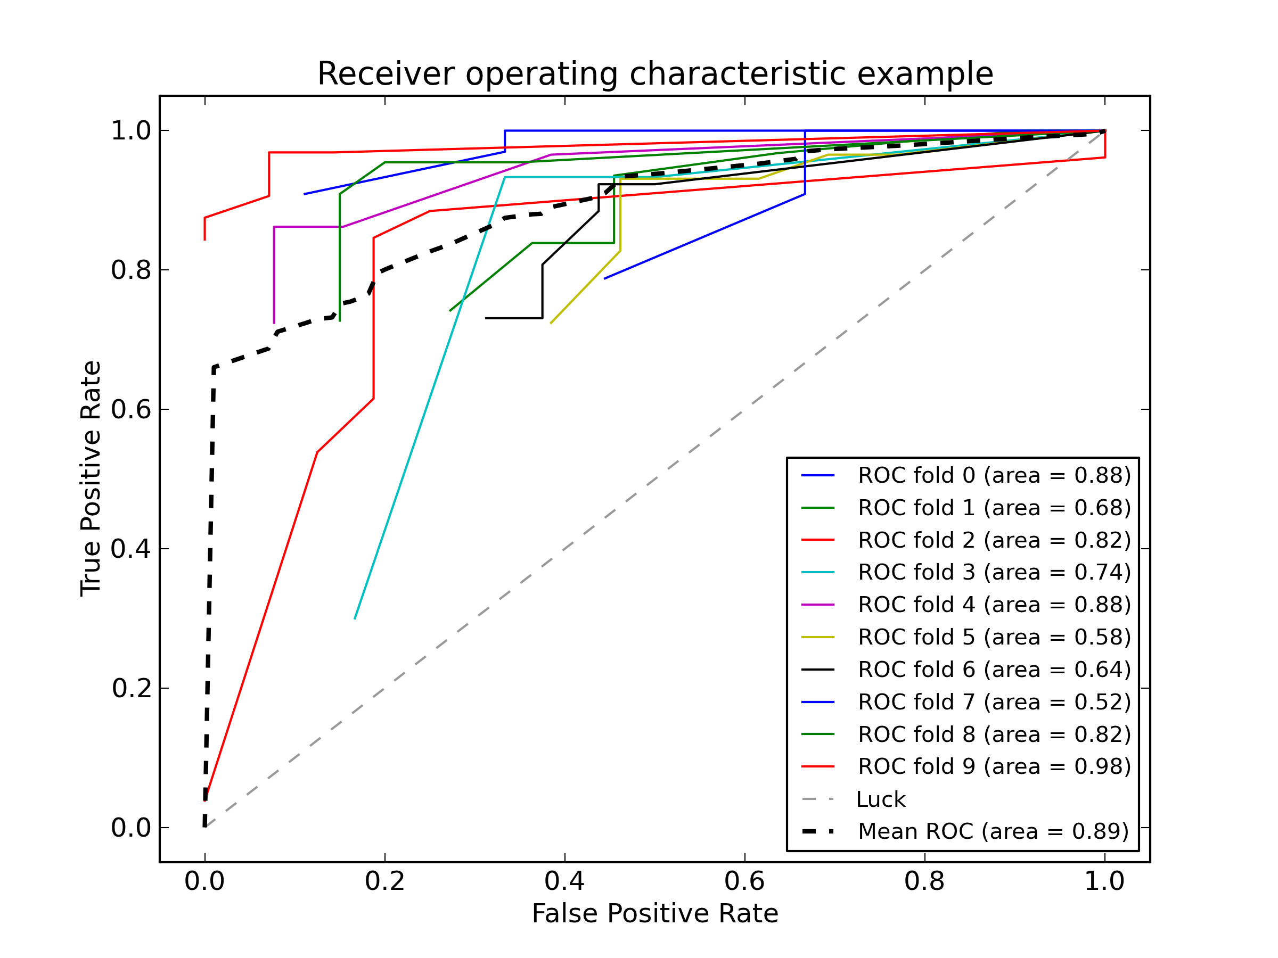
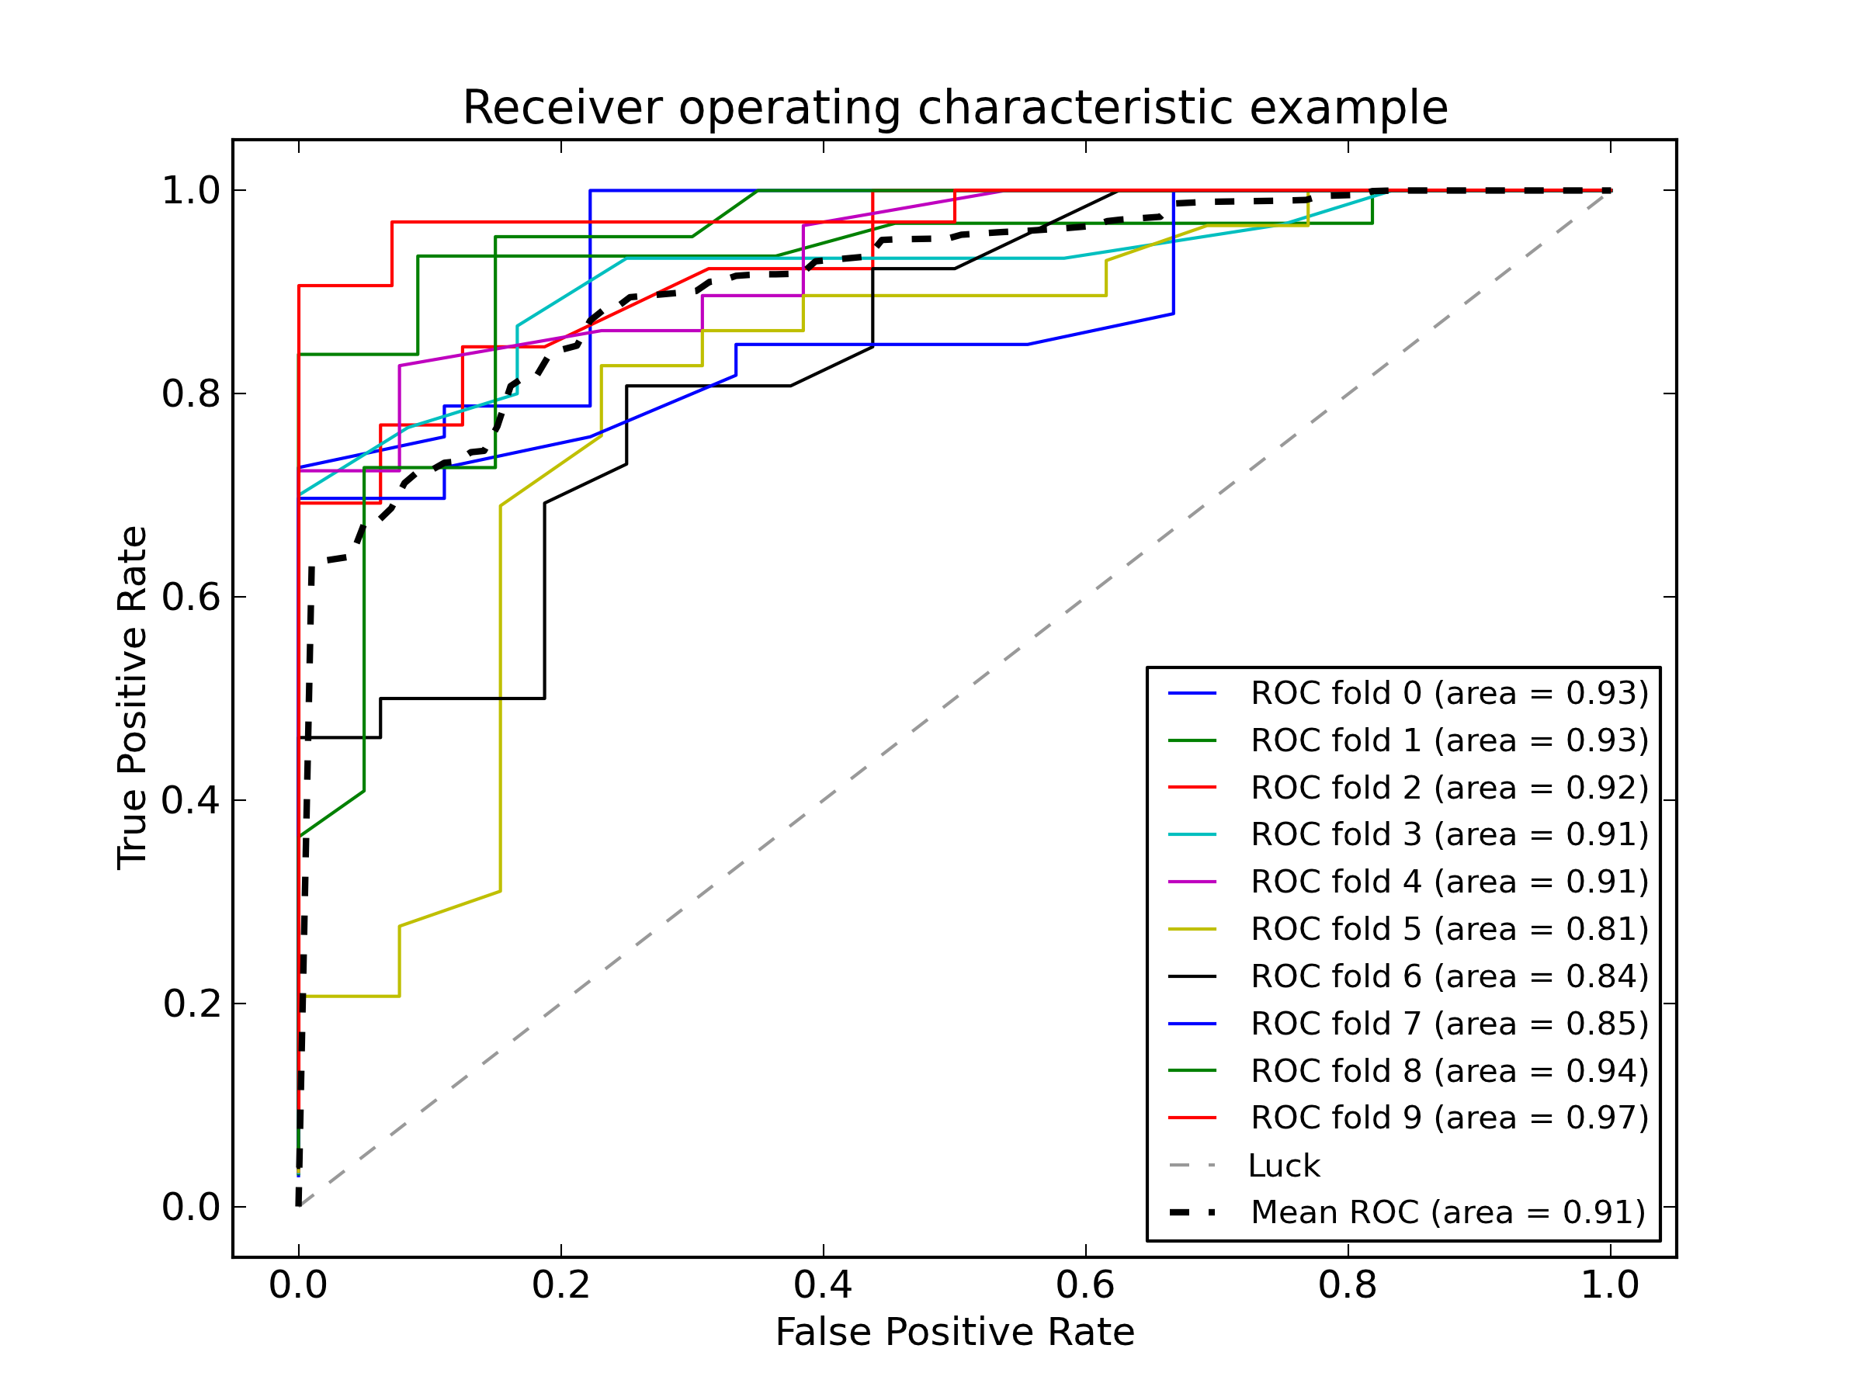
Models – Take One
Stacking w/ Logistic Regression
Stacking w/ Multi-Linear Regression

Slide 17
Models
Let’s be honest. That sucked. Why?
ROC Curves for each CV has a lot of variance, no matter which model we try it on.
How to improve? PUT ALL THE FEATURES!
Player’s win rate on that map
Opp’s win rate on that map
Player’s win rate against opp’s race
Opp’s win rate against player’s race

Slide 18
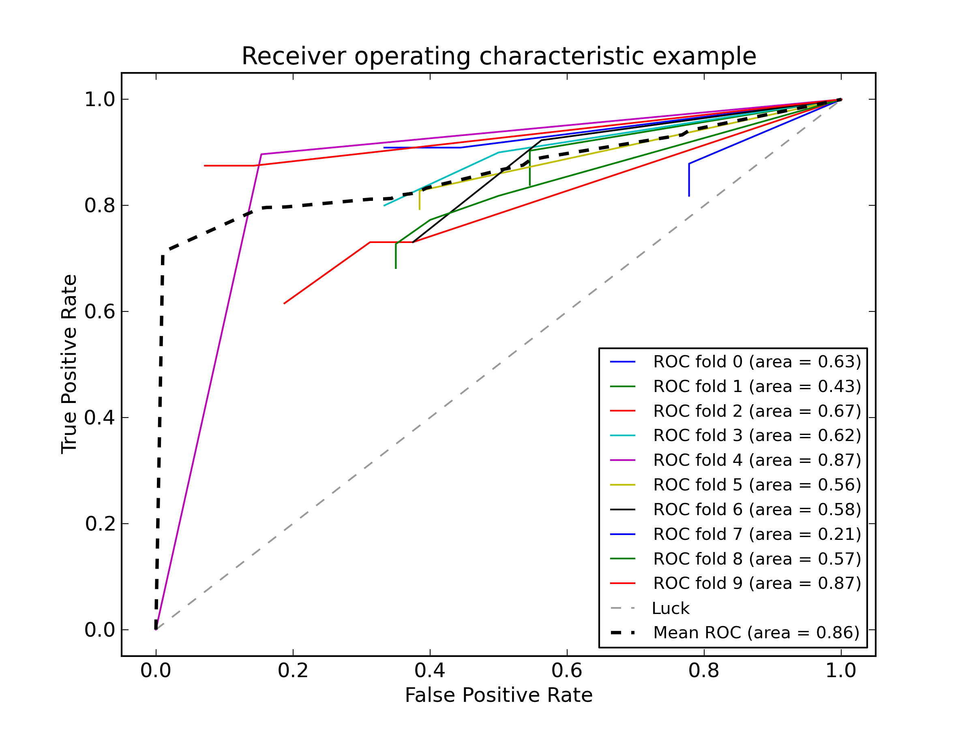
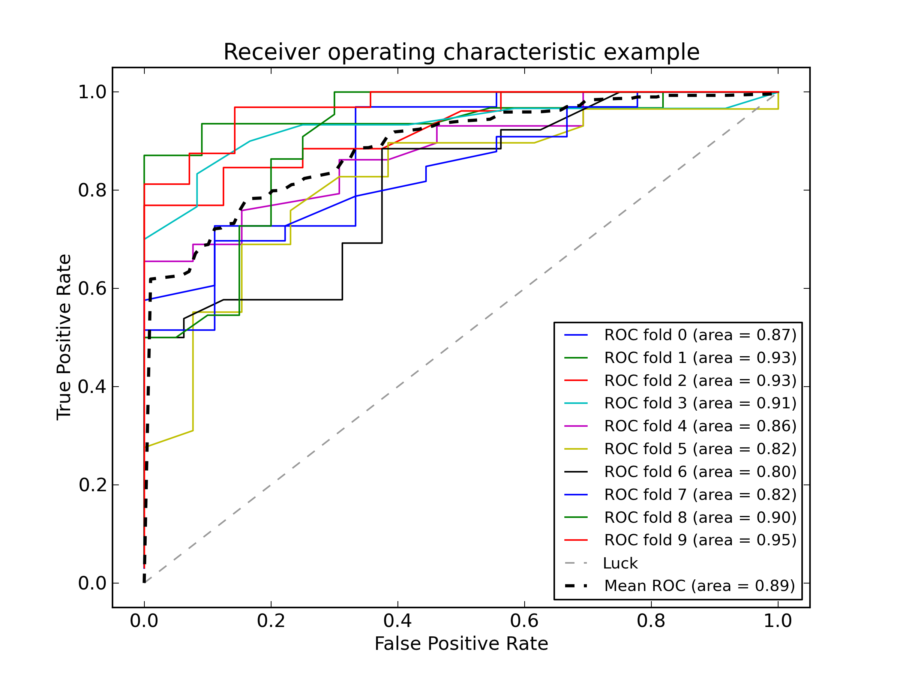
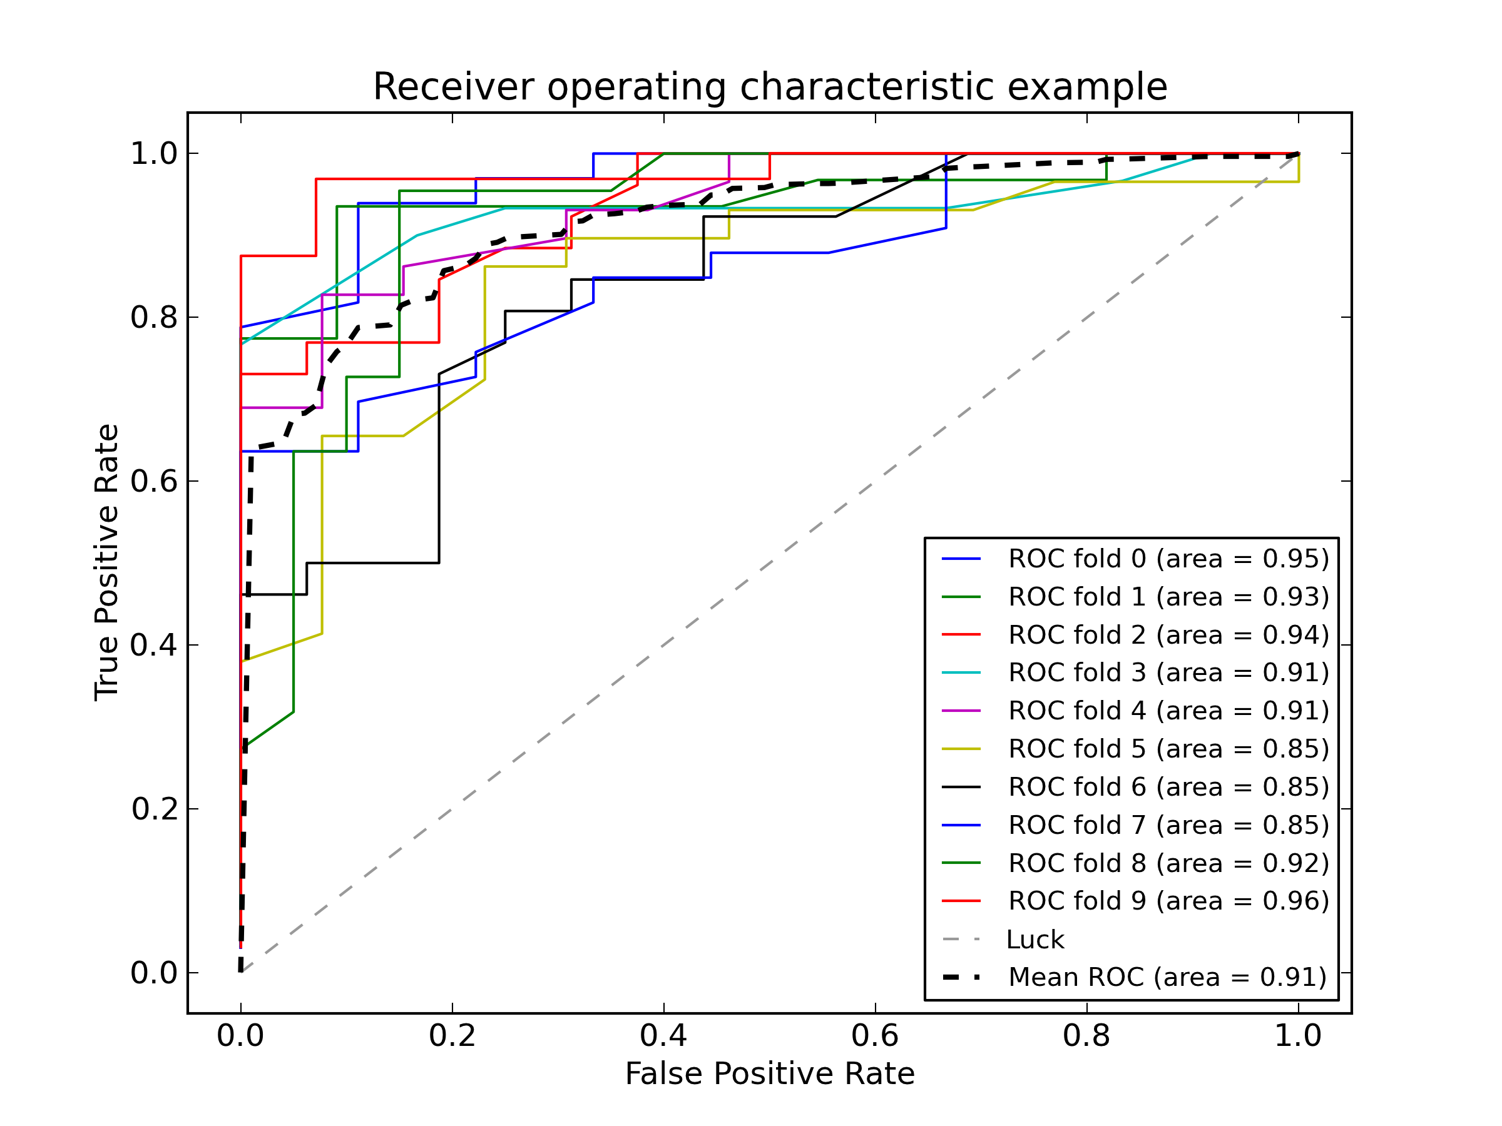
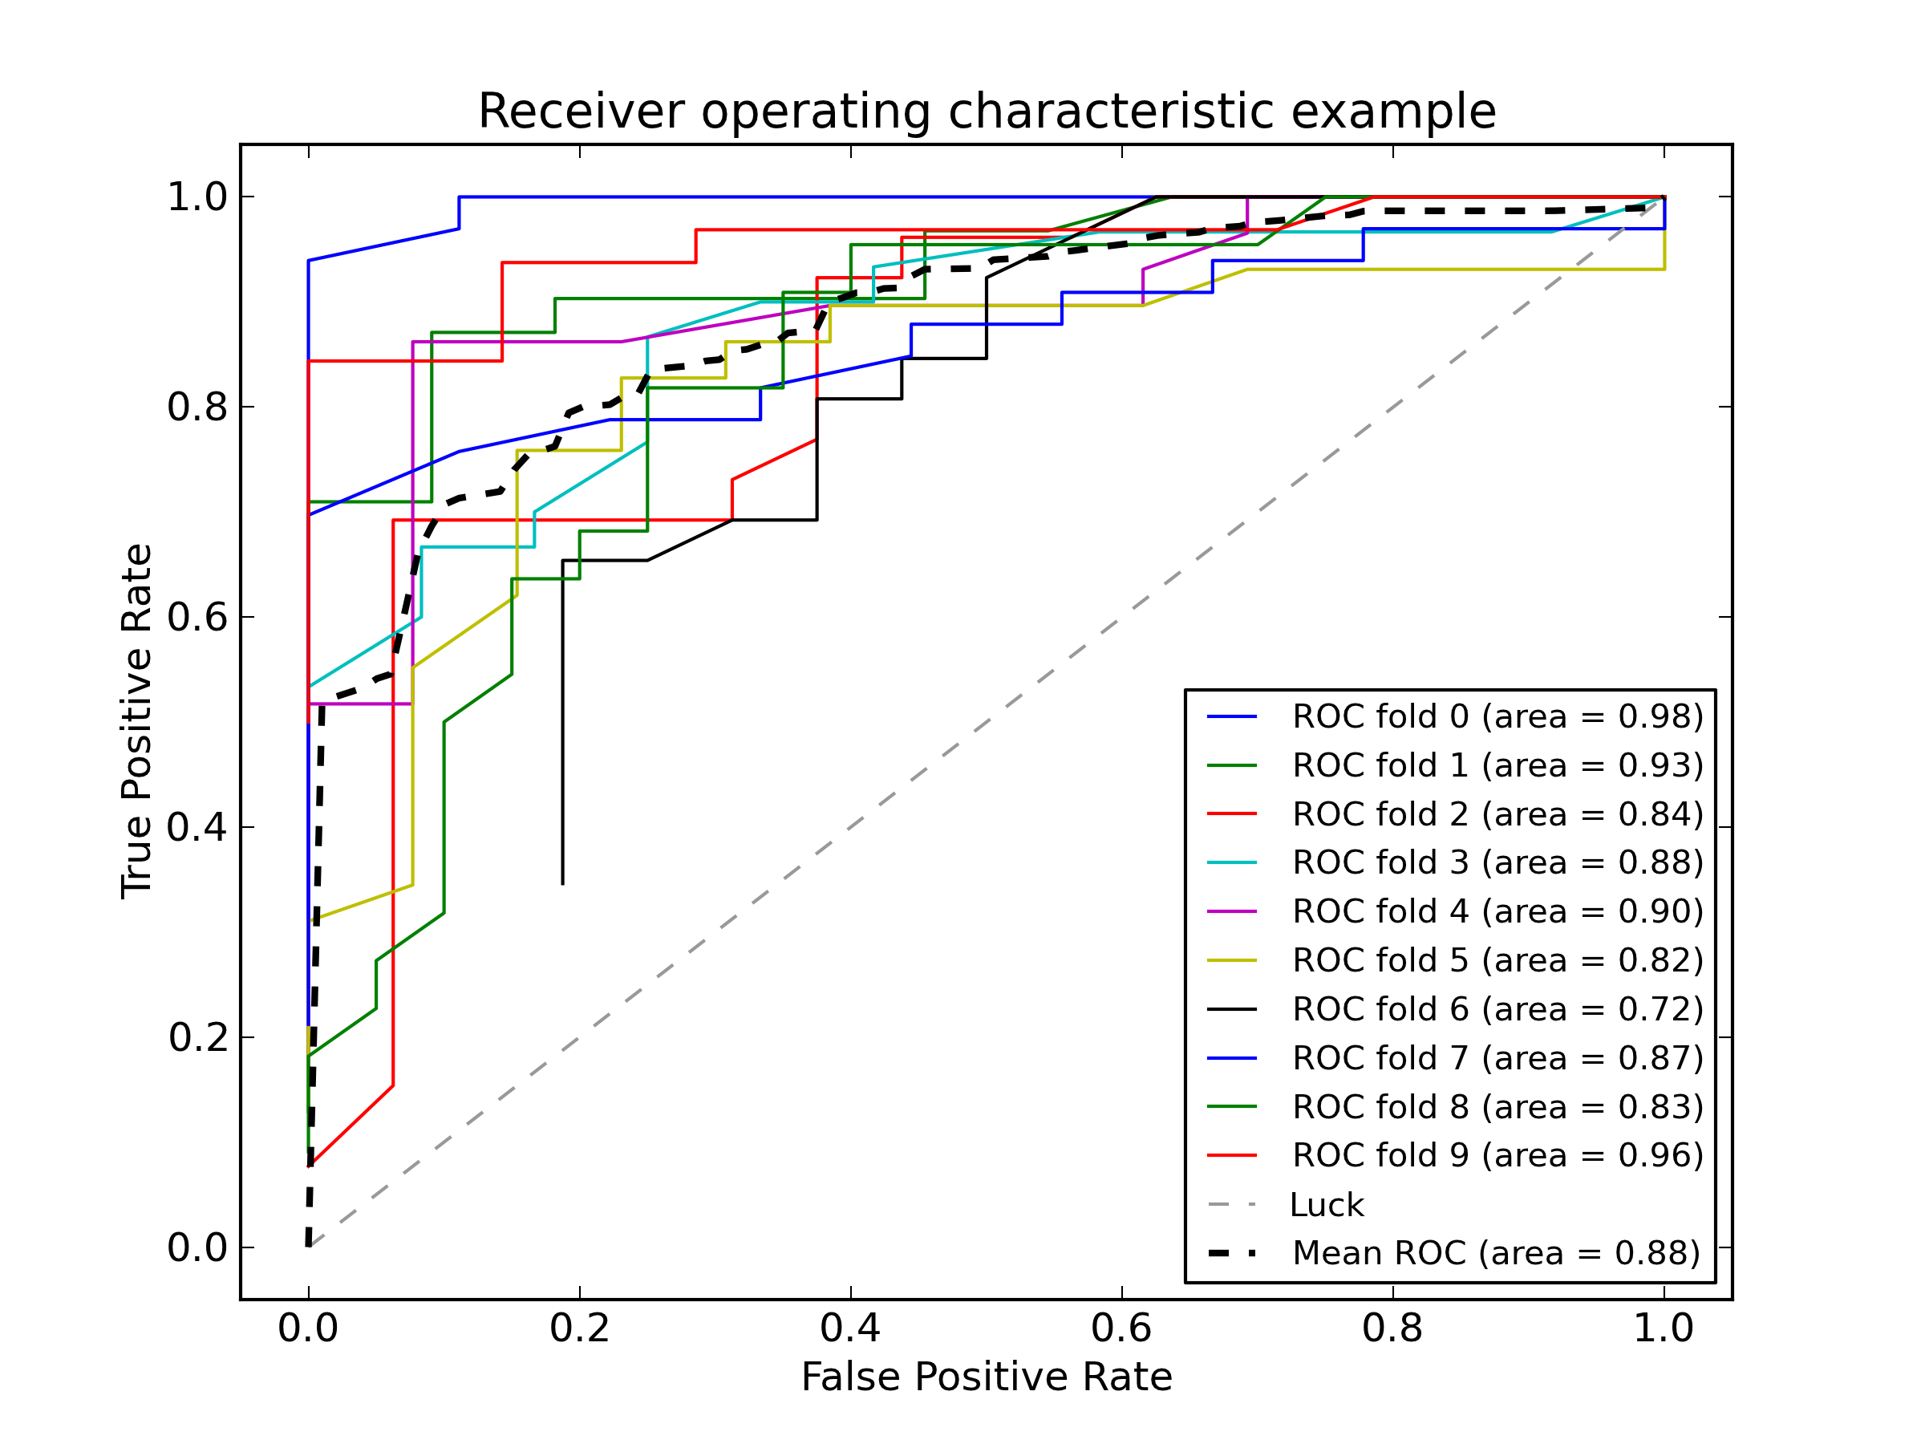
Models – Take Two
Logistic Regression
Decision Tree
Multinomial Bayes
Support Vector Machines
Random Forests

Slide 19
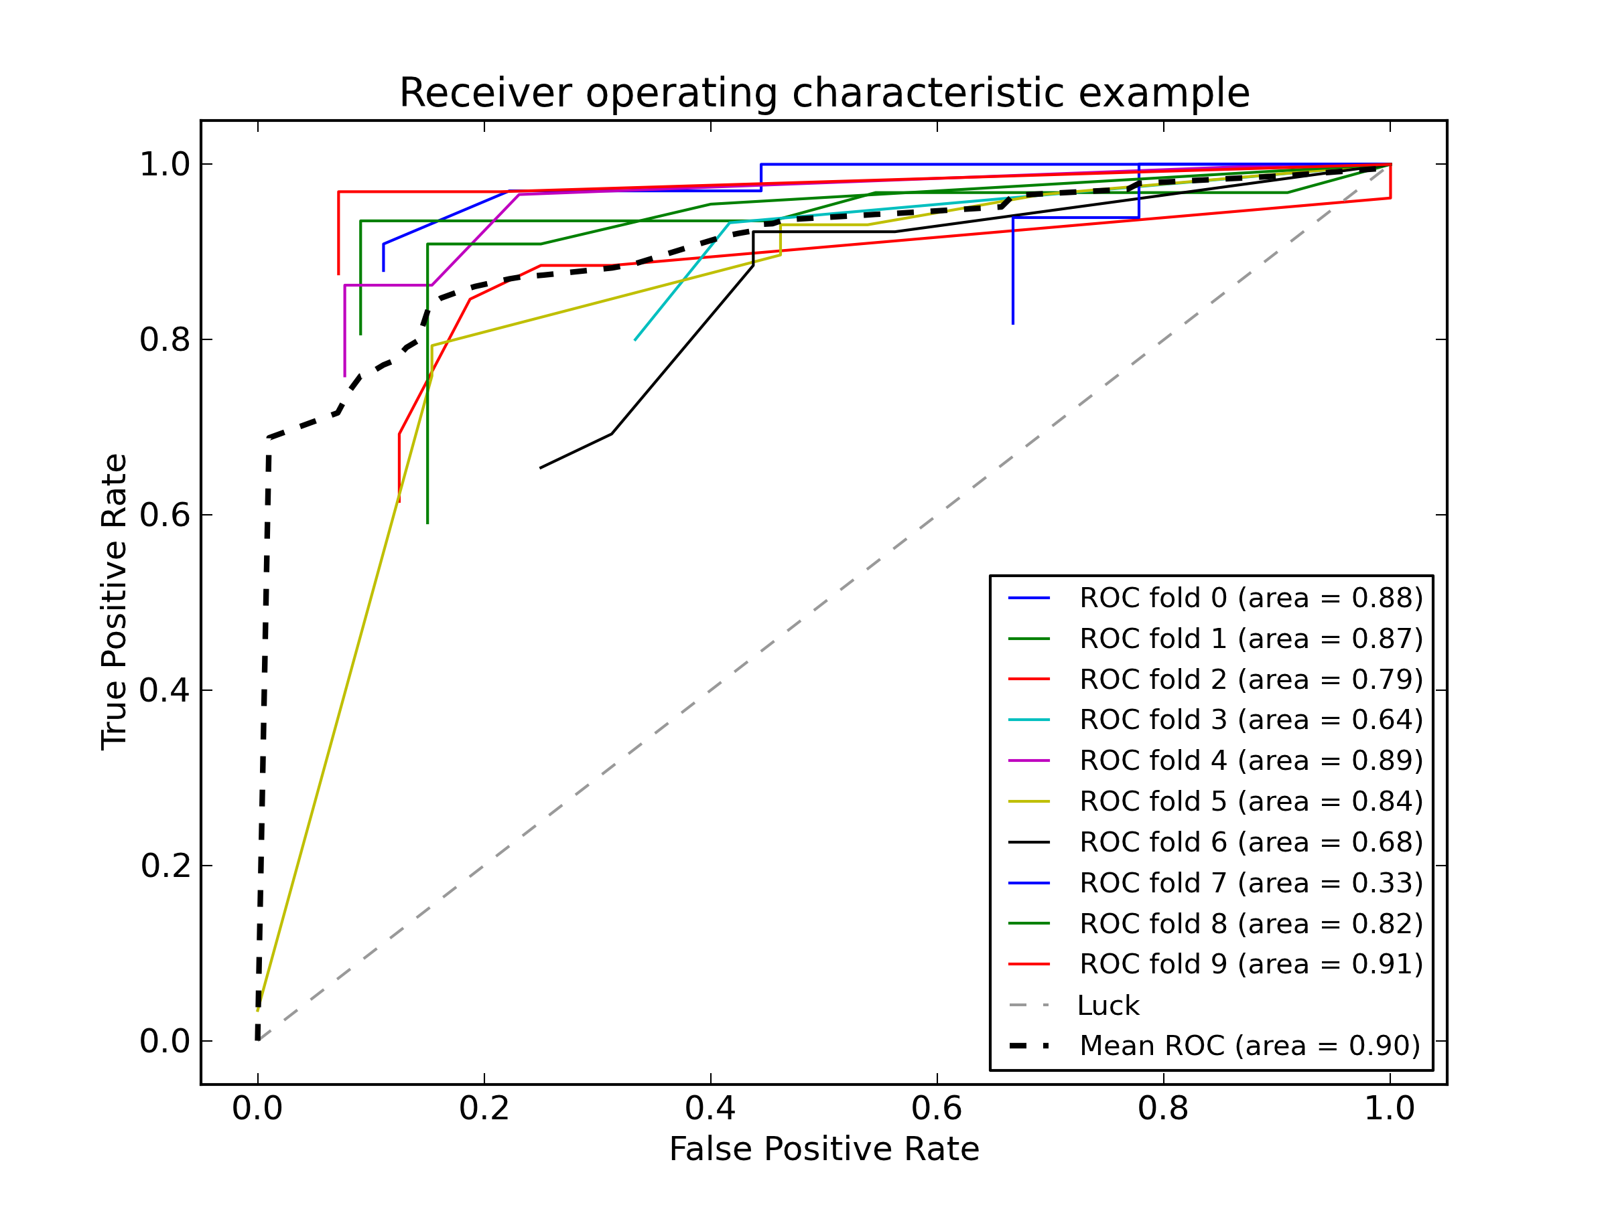
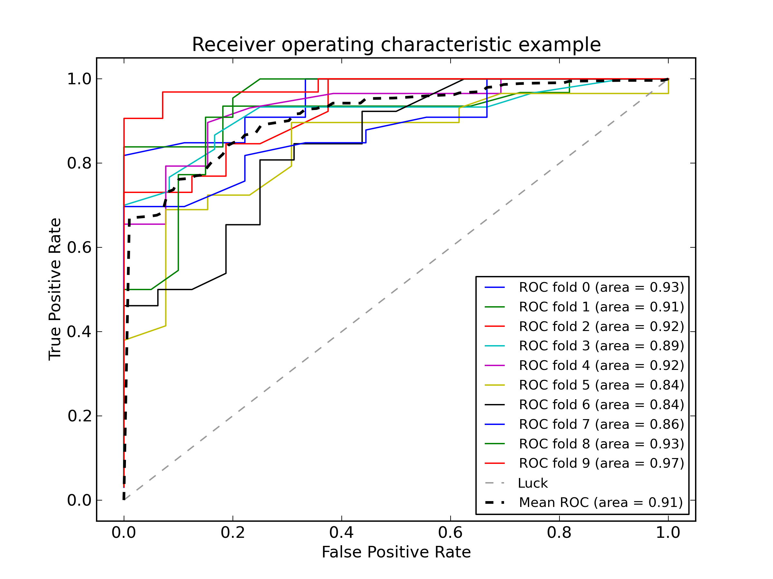
Models – Take Two
Stacking w/ Logistic Regression
Stacking w/ Multi-Linear Regression

Slide 20
Models
Stacking MLR model is still the best overall.
Let’s try it!

Slide 21
Models
MOMENT OF TRUTH:
Can our classifier correctly ‘predict’ who will win a Starcraft II match?
DEMO

